Slide 1
A Profitable Long-Only Momentum Trading Strategy for Individual Investors
Based on 1000 stocks from 1995 to 2020
4.27.20 Zihao Li

Slide 2
1. Introduction
Individual investors often suffer loss
Momentum strategies are profitable
2. Dataset Description
3. Momentum Strategy
4. Conclusion & Evaluation
5. Trading Result

Slide 3
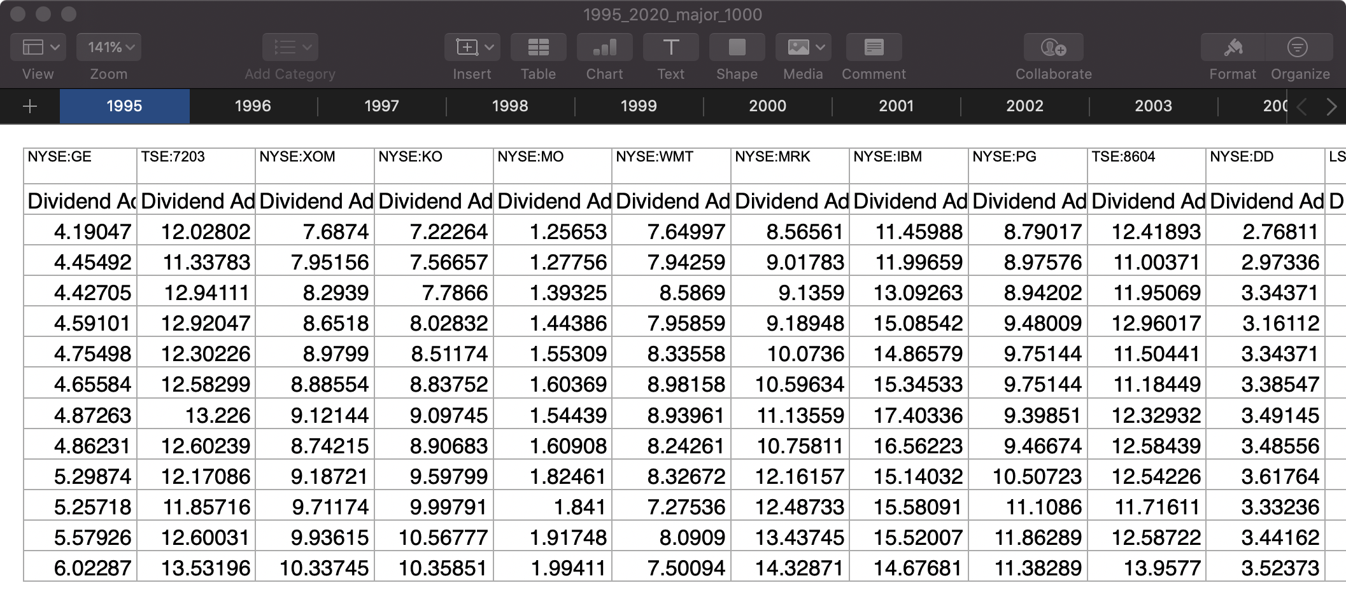
2. Dataset
26 sheets from 1995 to 2020
1000 tickers in total
January
February
March
April
May
June
July
August
September
October
November
December

Slide 4
3. Strategy
year_span = range(1996, 2020)
portfolio_size = [1, 5, 10, 50, 100, 500]
trading_period = [1, 2, 3, 4, 6, 12]
1996
1000 stocks
formation period
12 months
50 best stocks
testing period
12 months
trading period
1 months
1997
January 1
buy 50
rebalancing 50 best stocks
1997
February 1
buy 50
rebalancing and trading 12 times
6 * 6 combinations
for 24 year
864 returns
12 average returns
1997
February 1
sell 50
1997
March 1
sell 50
average return
average return
final return

Slide 5
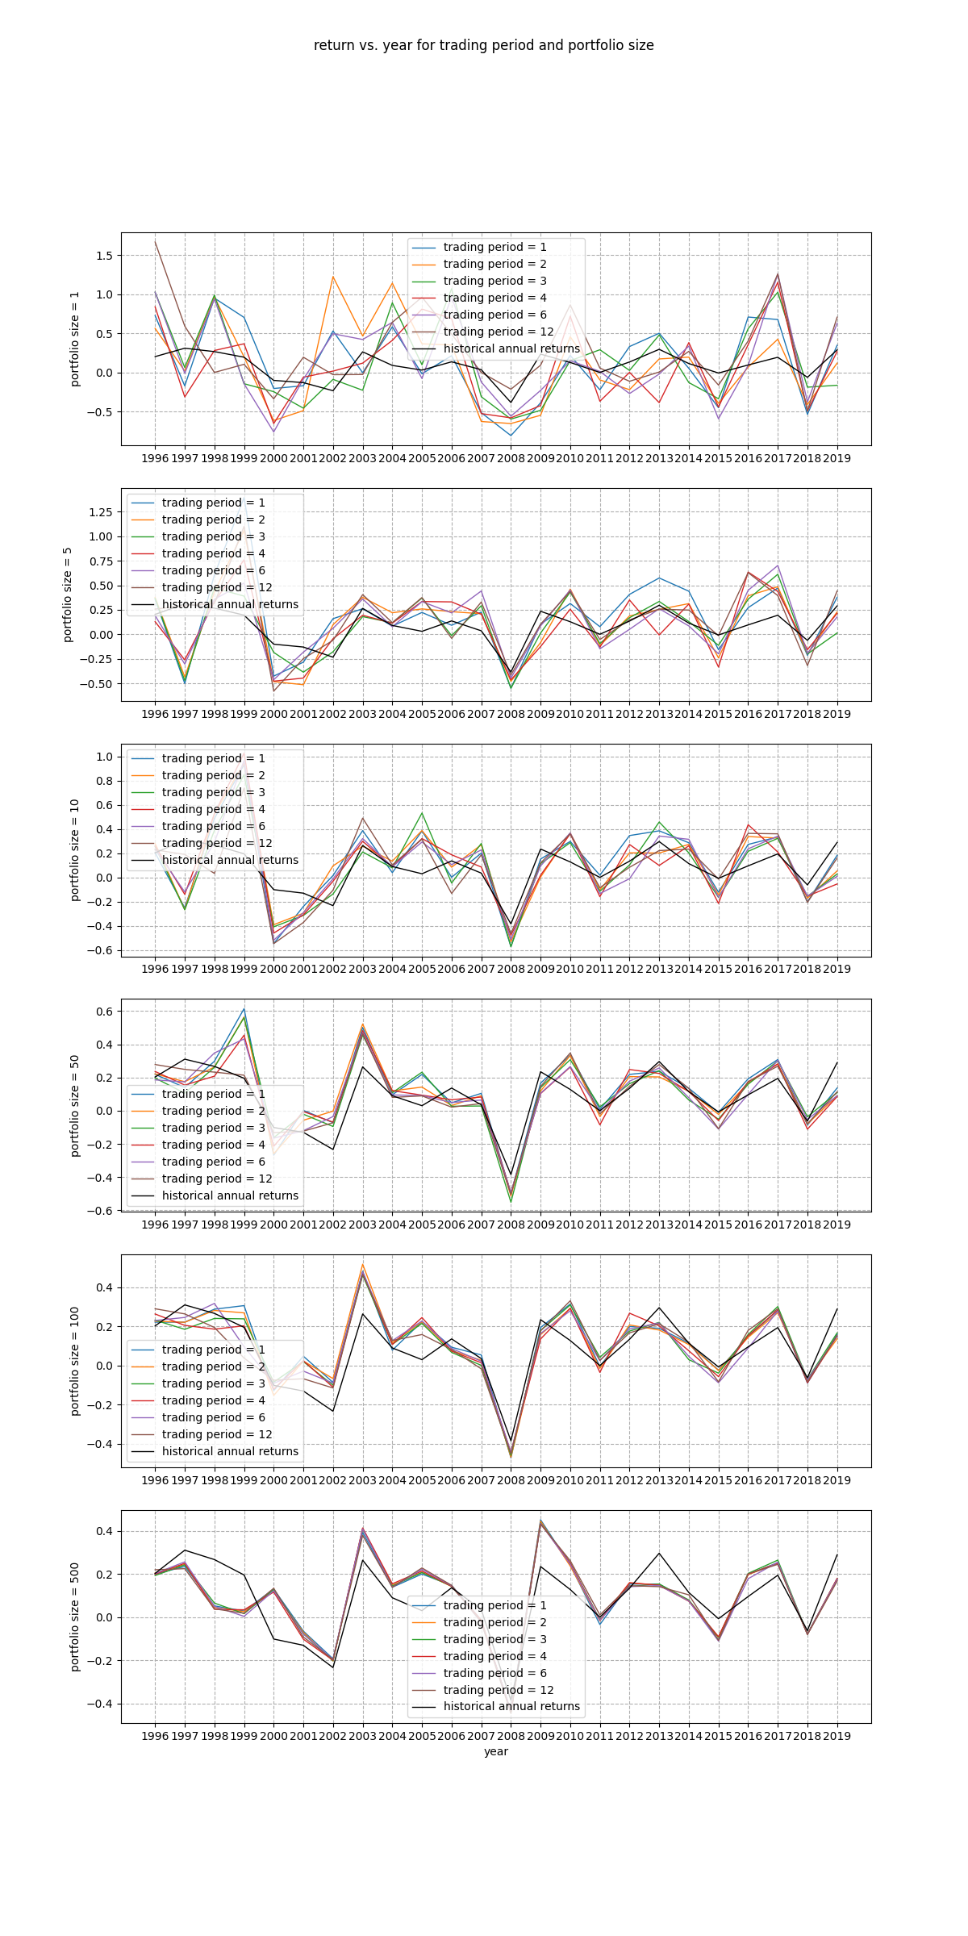
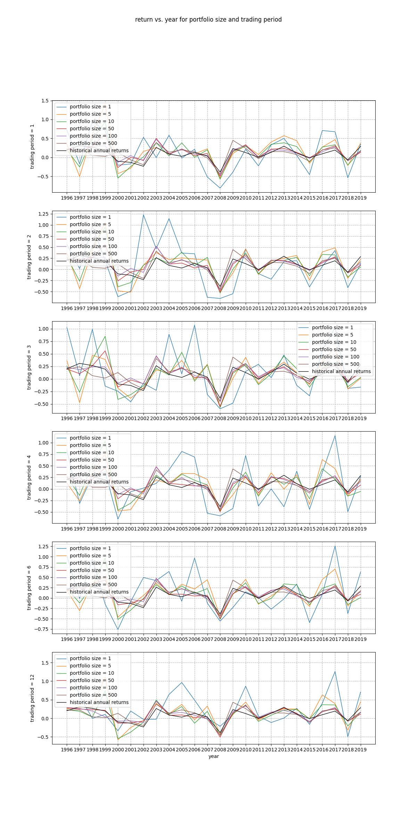
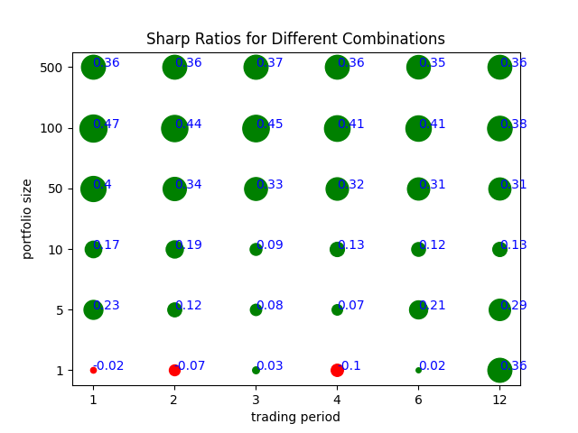
4. Conclusion

Slide 6
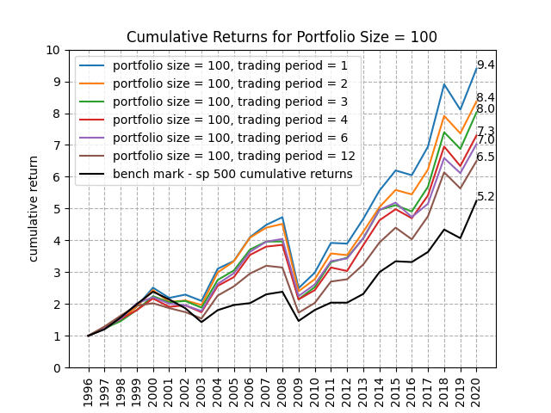
5. Trading
Thanks for Watching!
Questions?

